Slide 1
Naveen Boutqiue App

Slide 2
Introduction
Welcome to the Naveen Boutique! During this presentation, we will demonstrate the seamless flow of screens that define the Naveen Boutique experience. You can explore the hottest trends, shop with ease, and dive into the world of fashion from your phone. Let's explore the stylish adventure together!

Slide 3
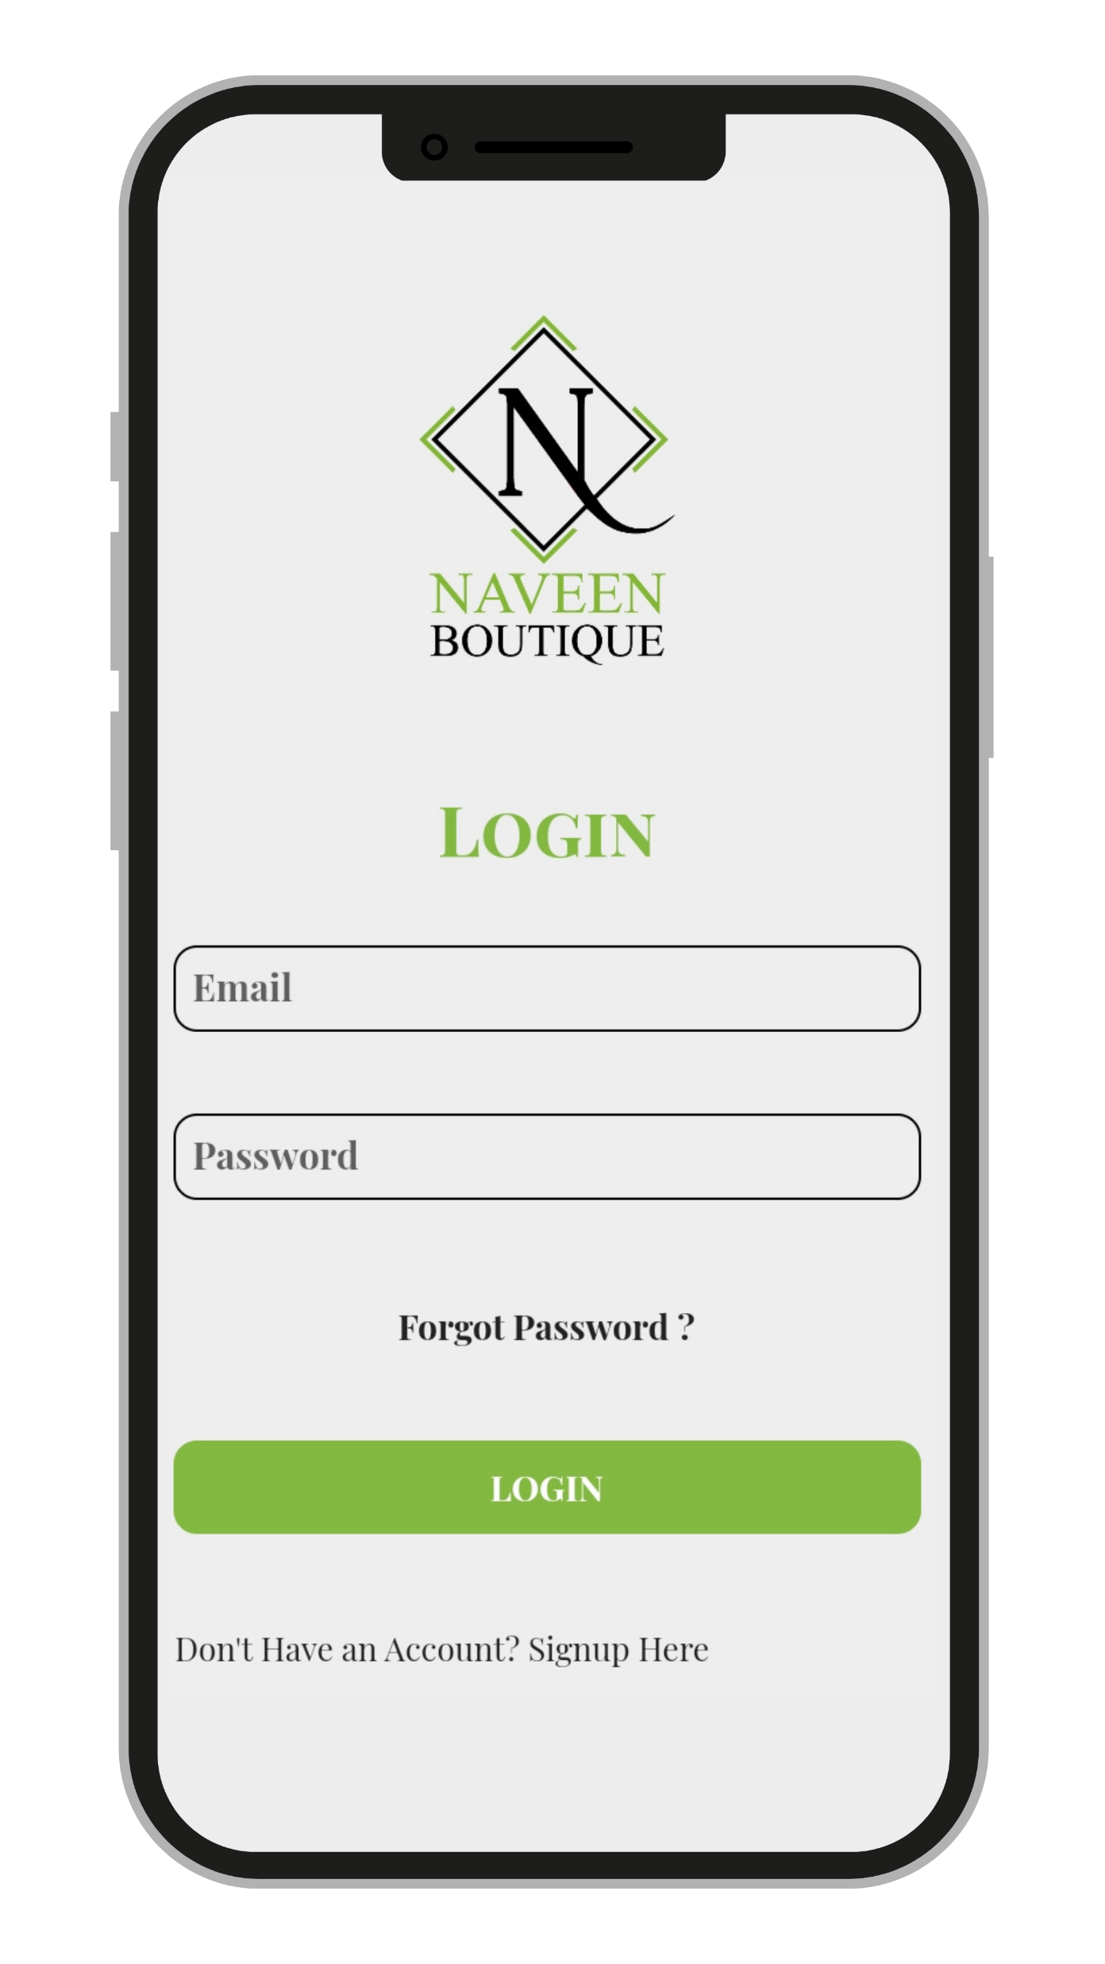
User Login Screen
The user must first register with Naveen Boutique in order to log in.
To register, the User must provide their Name, Email, Phone number, Complete Address, and a strong password.
The user will receive a verification email after providing the above information.
Passwords can be changed if the user forgets them.
The user must provide an email address and a password in order to log into Naveen Boutique.

Slide 4
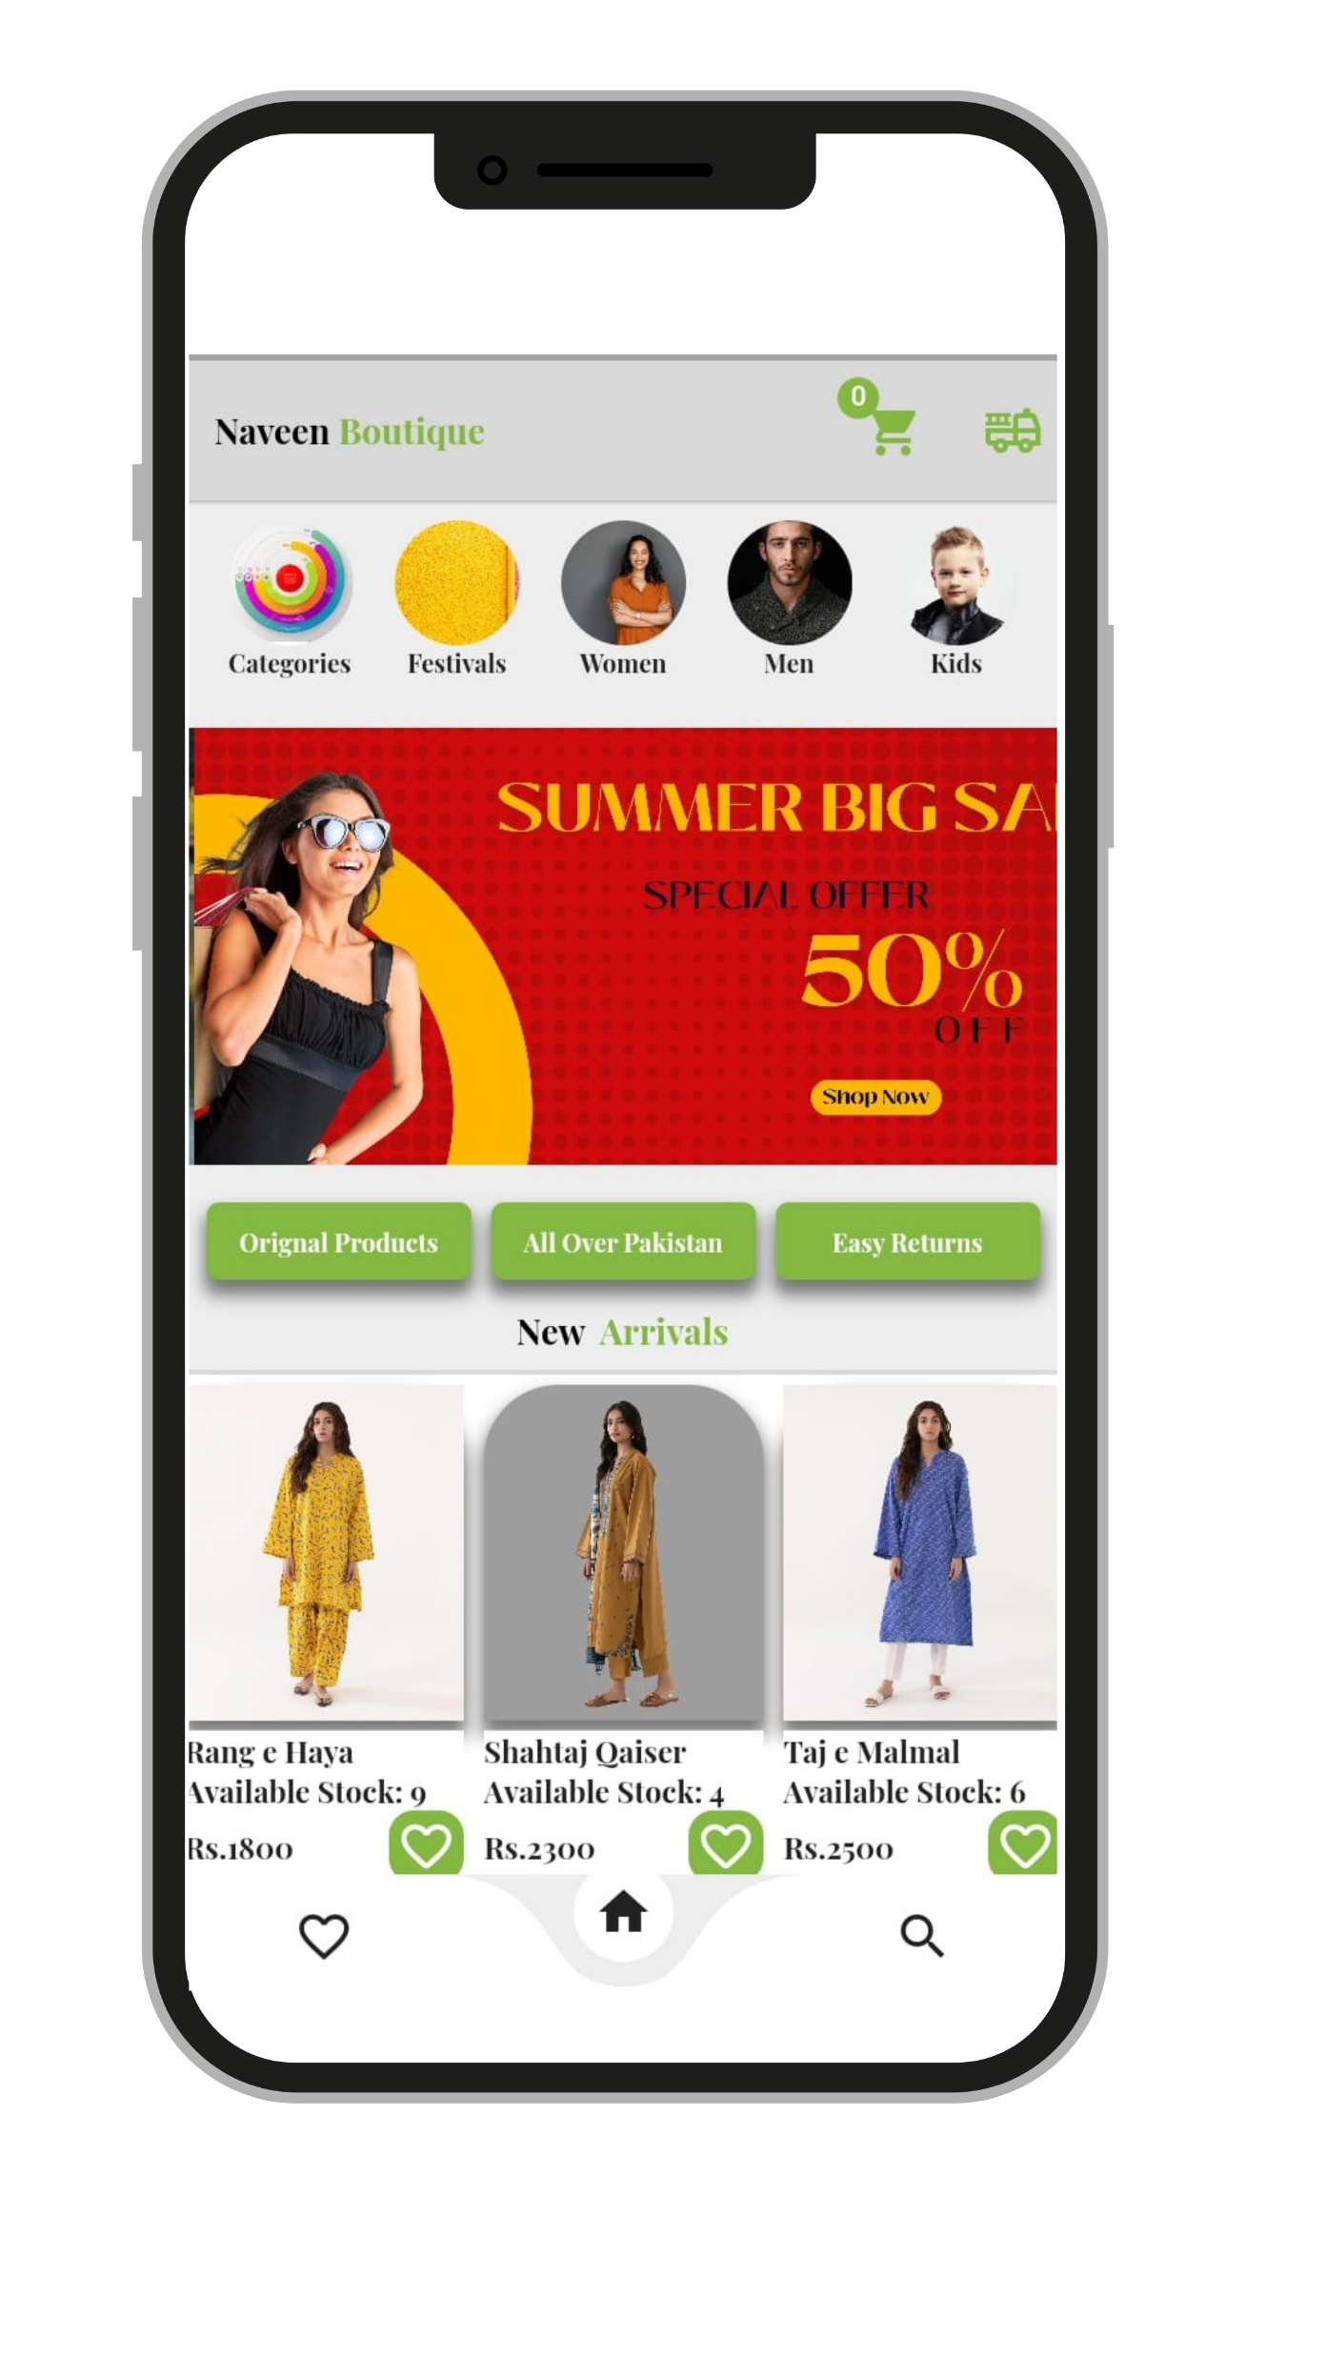
Home Screen
In the top bar of the home screen, there are icons for the brand name, cart, and order tracking.
All categories are listed below the top bar.
After this, there is a slider for the Hero Section.
Then there are two sections for trending products and new arrivals. There is also a slider in these sections. The products can be slid.
The bottom of the page has icons for home, Wishlist, and search.

Slide 5
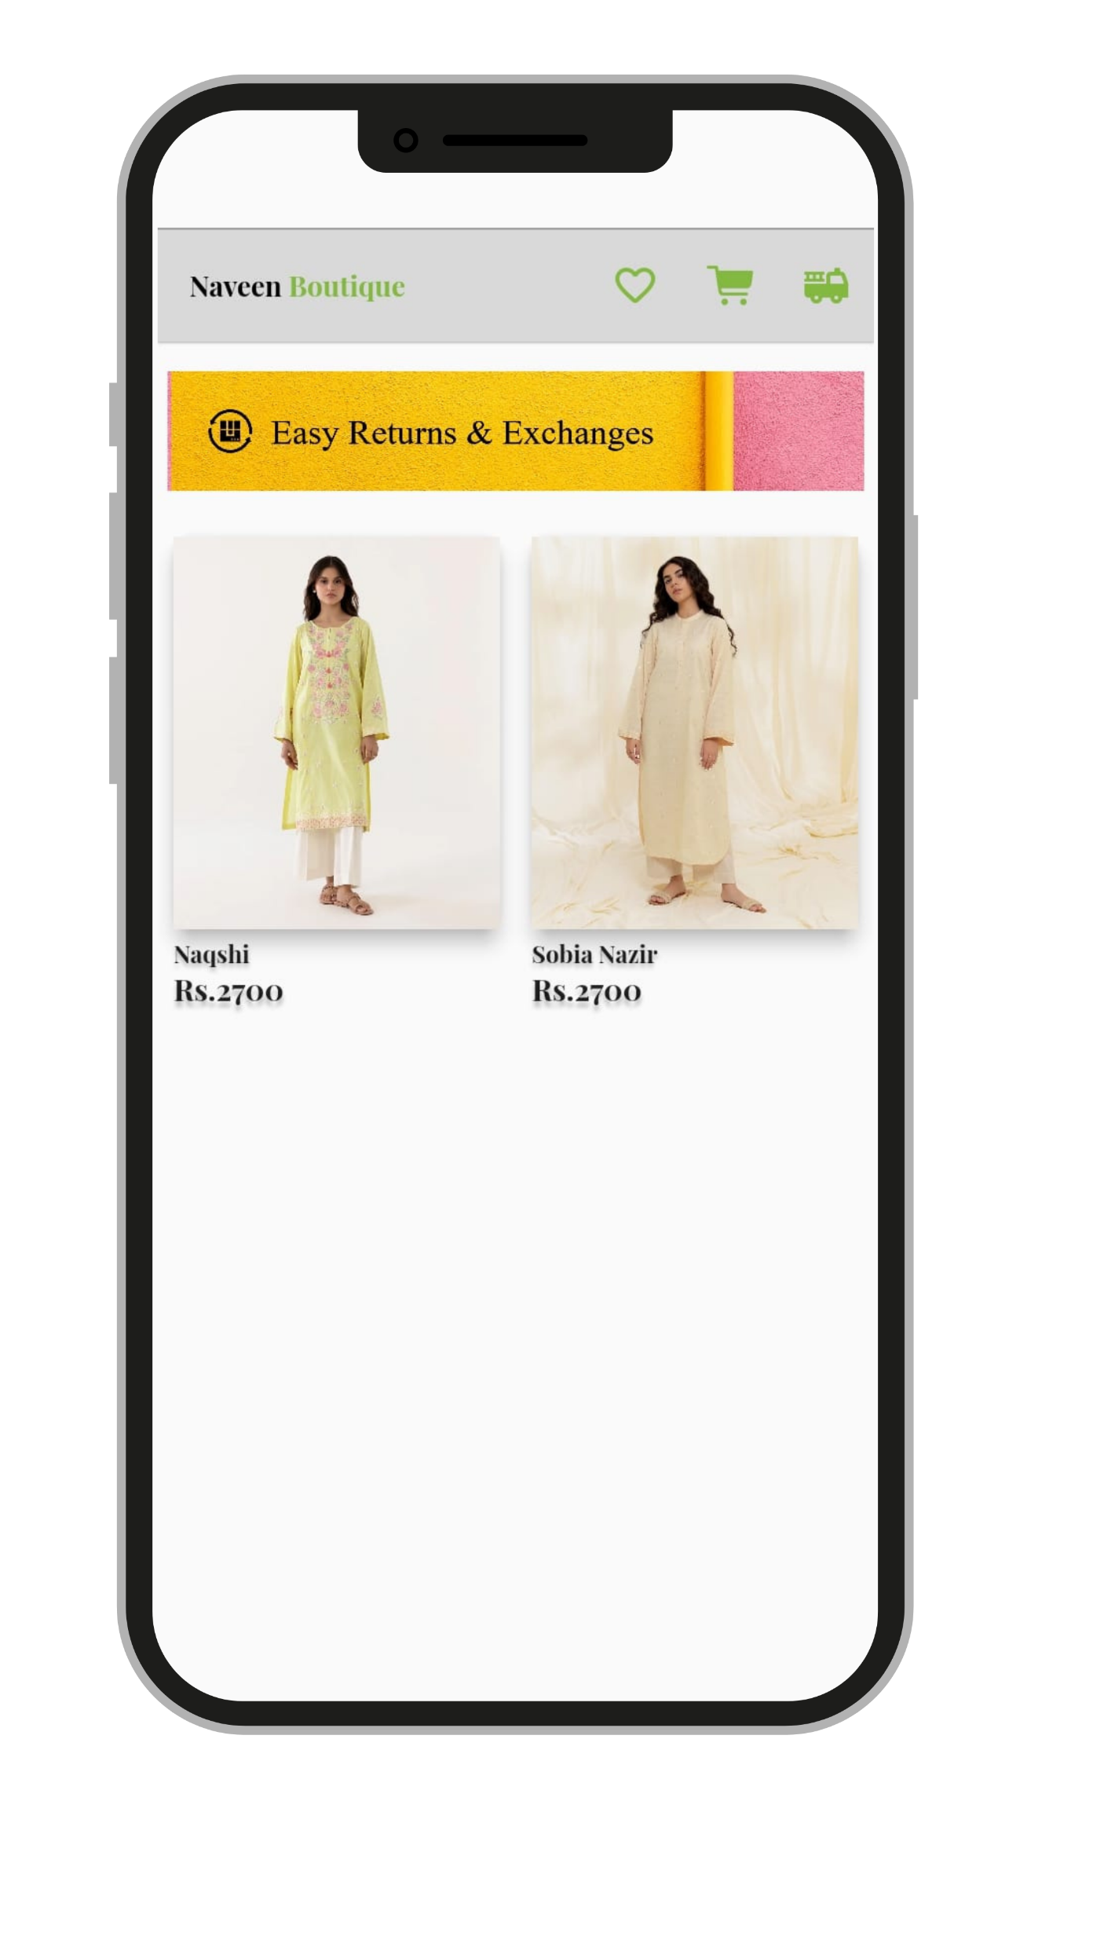
Shop Page
Our entire product line will be displayed on the shop page.
The products are also accompanied by "Return and Exchange Policies.".
Every product has its own name, price, and discount tag.
Any product can also be zoomed in to view it in full.
It is also possible for users to add any product to their Wishlist.

Slide 6
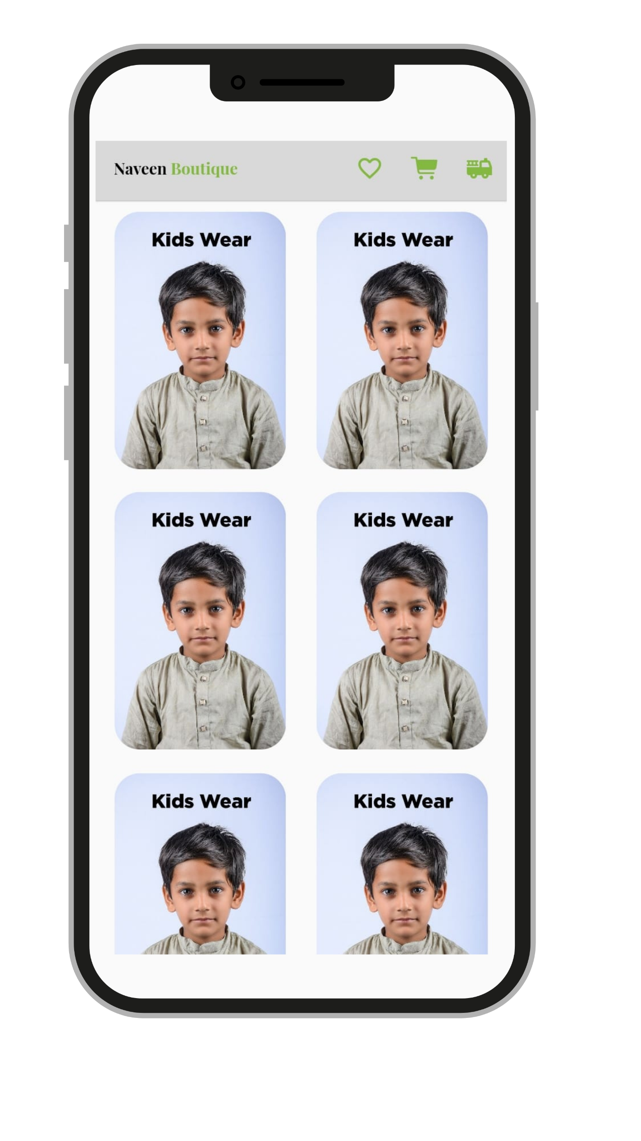
Categories Page
The user can view all our categories on the category page.
There is an image with a category name for each category.
Clicking on the category image will take users to specific category products.

Slide 7
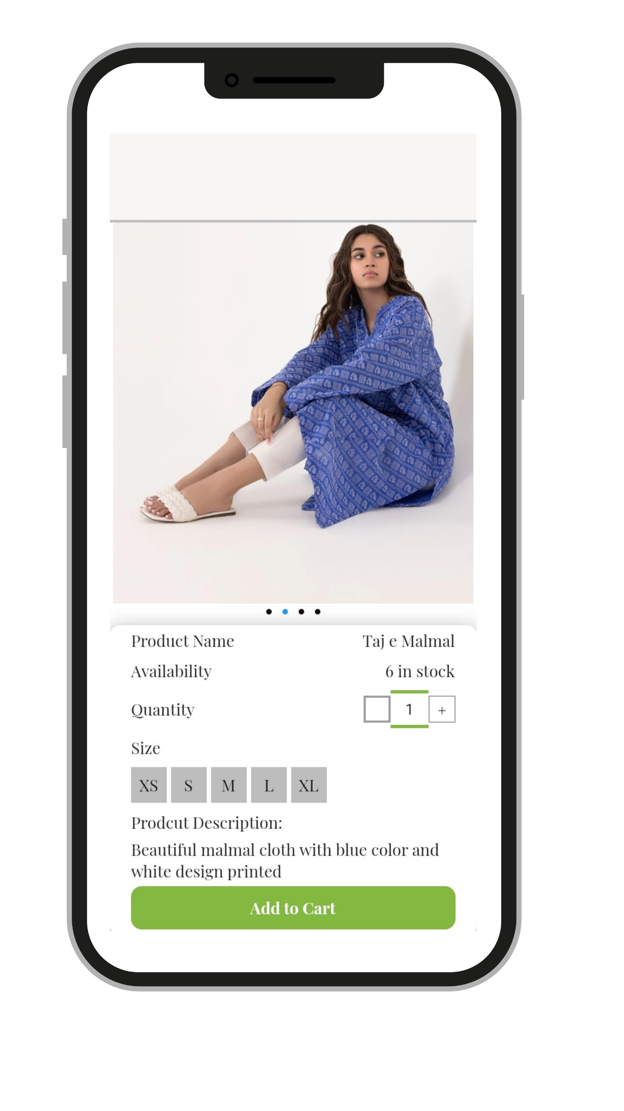
Product Page
Every product page has a carousel of four to five images.
The user can view the product name and availability in the product details section.
Additionally, users can select the quantity of any product, but they cannot select more than the amount of stock available.
The user must select the product's size.
Each product also has a description.
By clicking the "Add to cart" button, the user can place his order once all the above-mentioned details have been entered.
A pop-up will appear after the user clicks the add to cart button, allowing them to view their shopping cart or continue shopping.

Slide 8
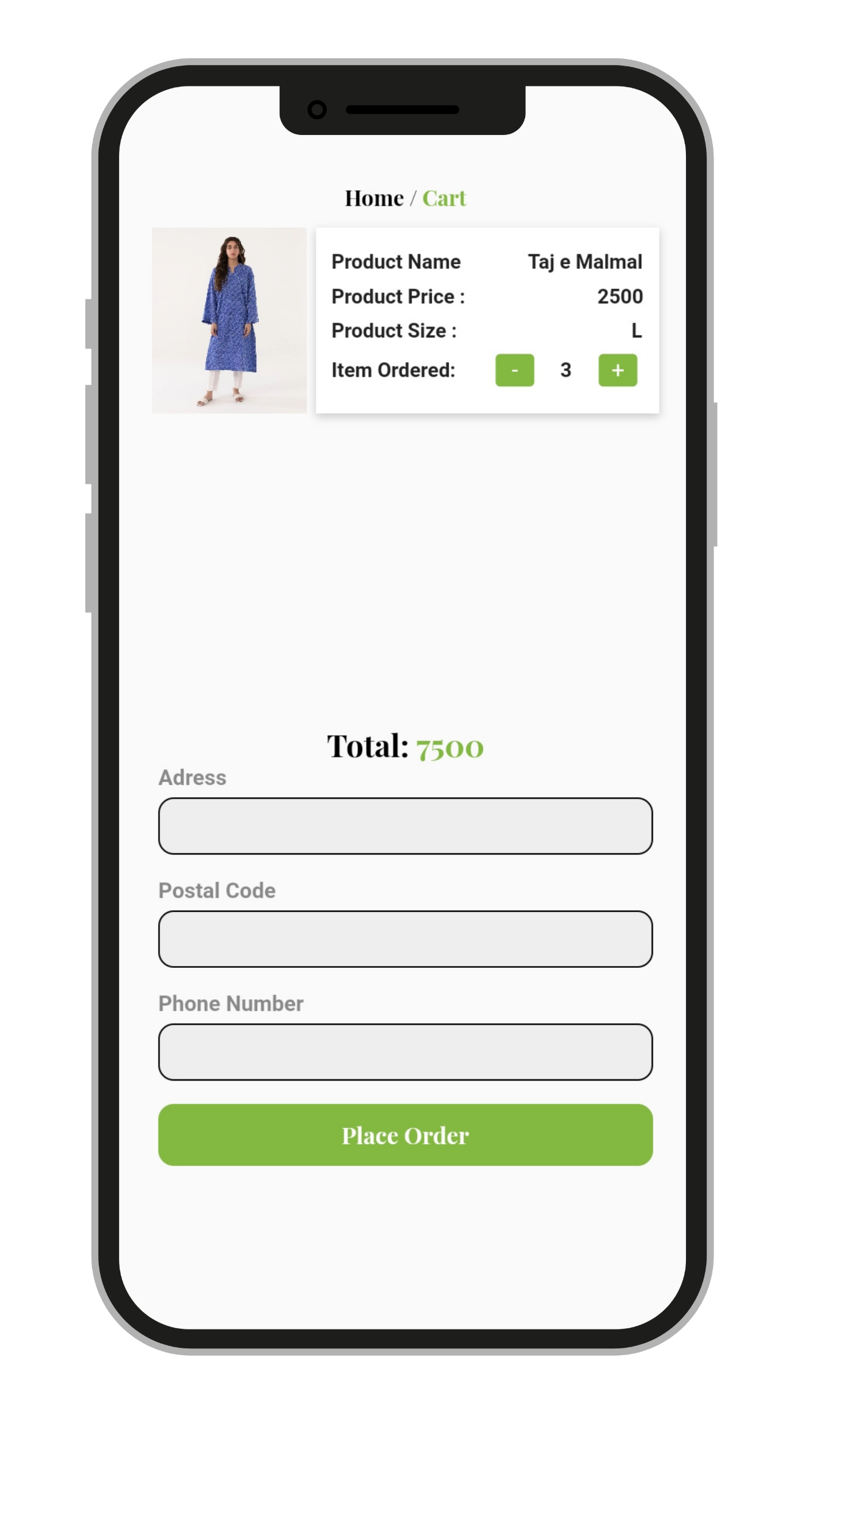
Shopping Cart Page
On the shopping cart page, the user can view all the products he has added to the cart.
A user can change the quantity of a product and the cart will be updated automatically.
The user can also see the total price of all products.
To place an order, the user must be logged in and provide address, postal code, and phone number information.
Clicking on "Place Order" will take the user to the next screen.

